Slide 1
Introduction to National HPC Infrastructure Ilyass Hankrir | ihankrir@ualg.pt Alexandre Gomes | ajgomes@ualg.pt HPCvLAB@UALGARVE 26 January 2026

Slide 2
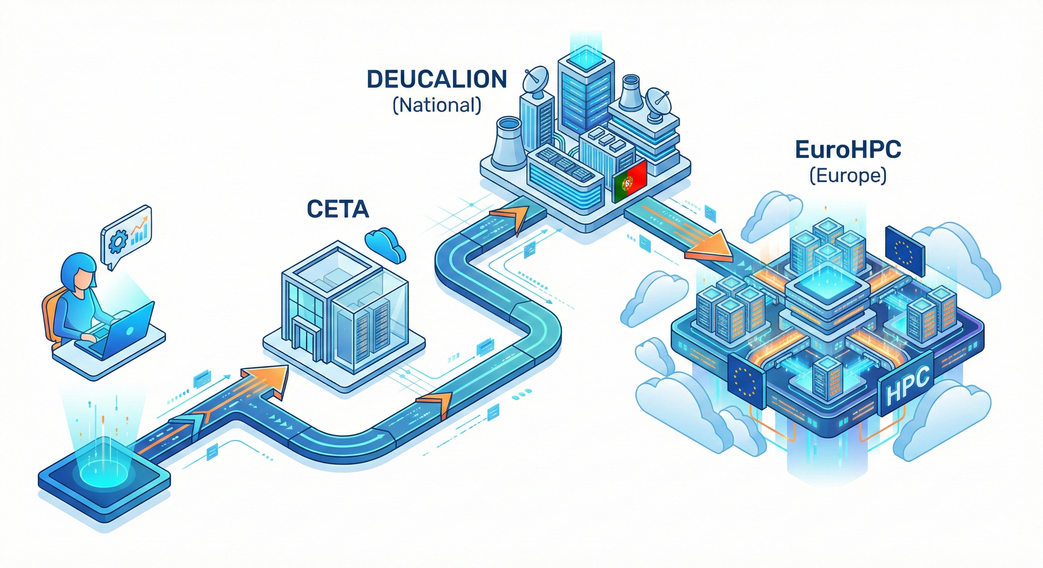
The Ecosystem

Slide 3
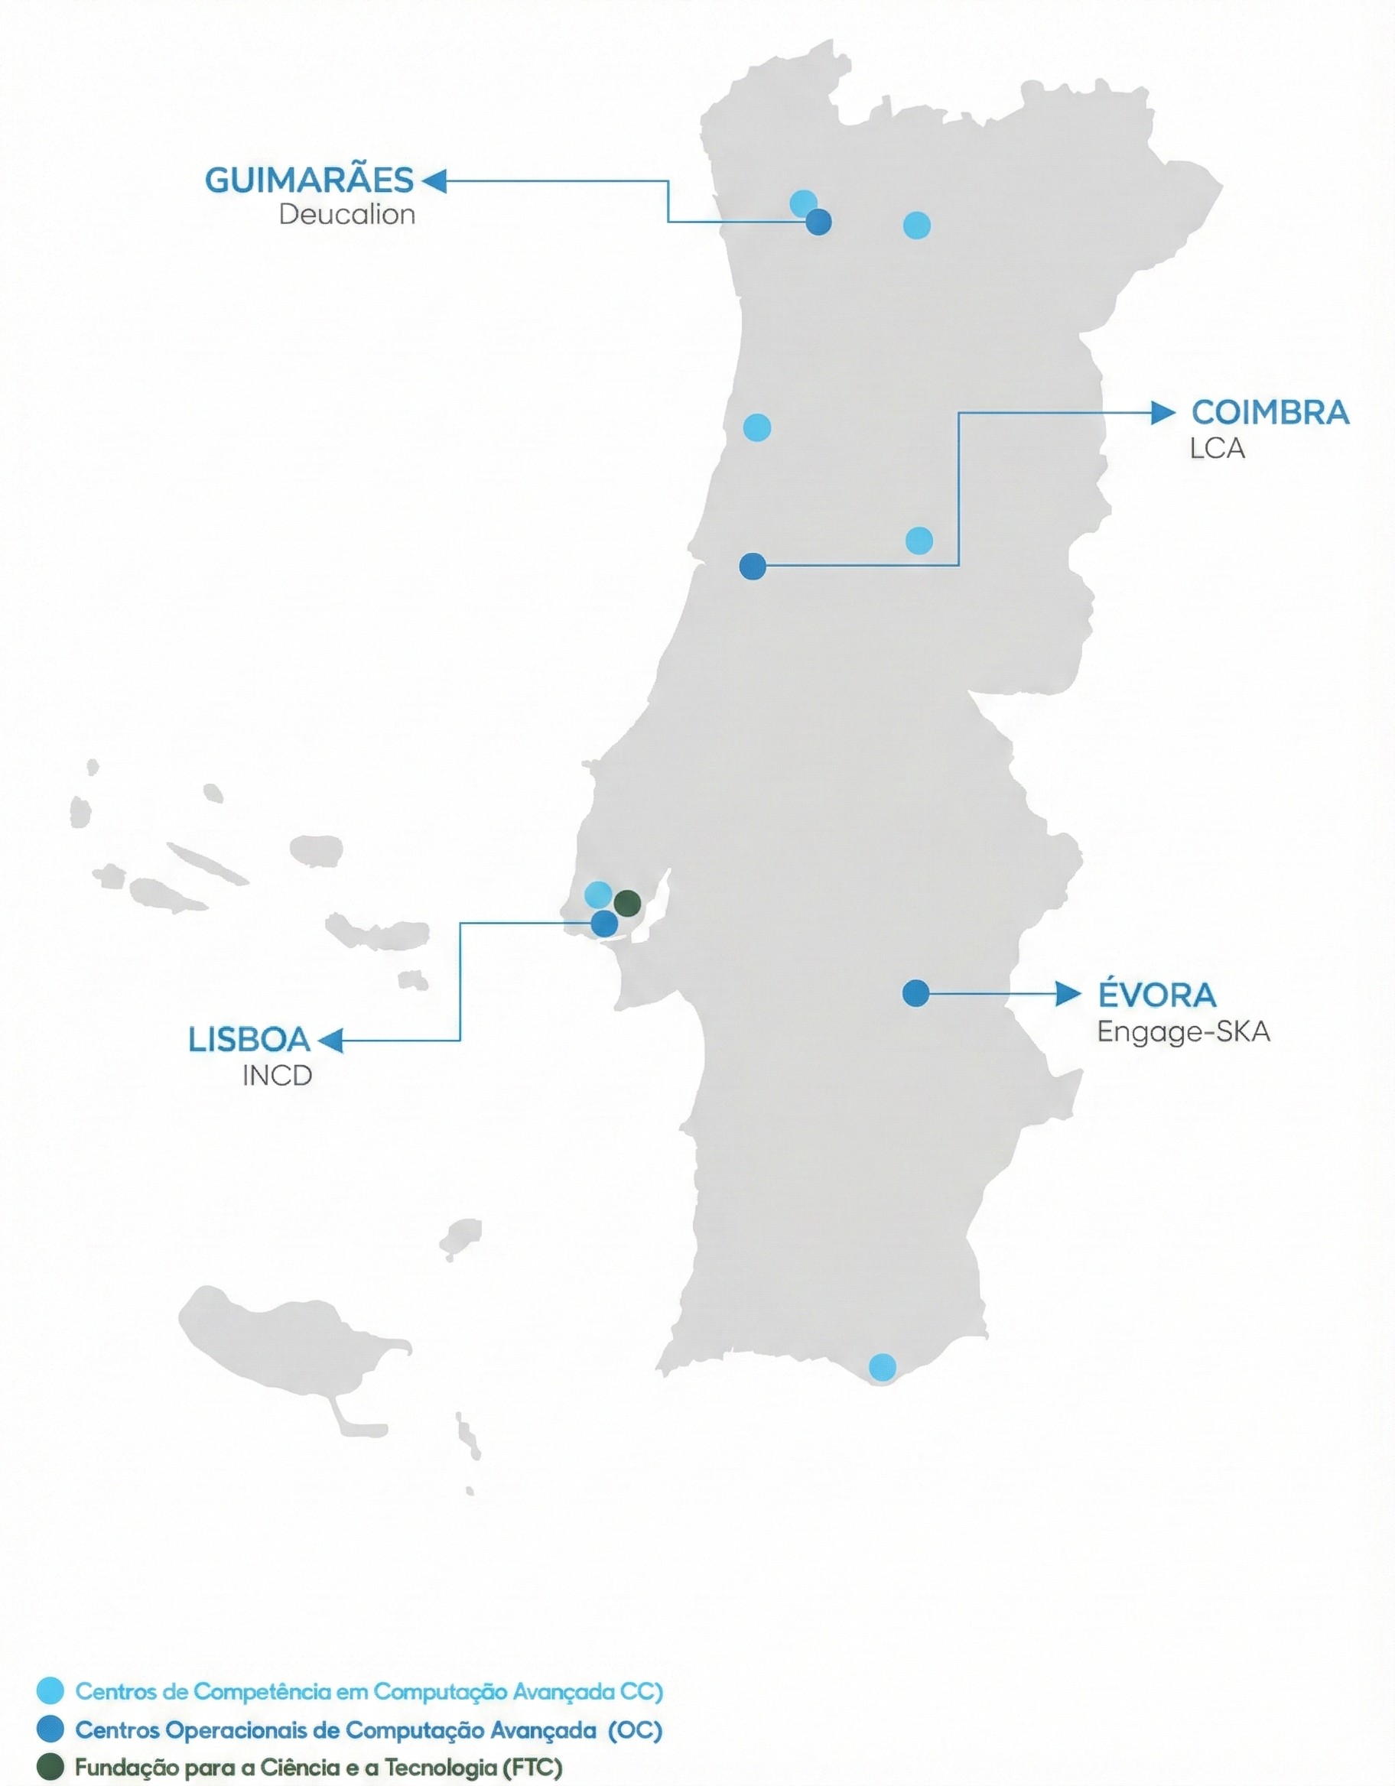
CNCA Network
Gateway to EuroHPC (Tier-0)
HPCvLab-Ualg
Faro
Source of figure: https://rnca.fccn.pt/en/rede/

Slide 4
HPCvLab-UAlg
https://hpcvlab.ualg.pt

Slide 5
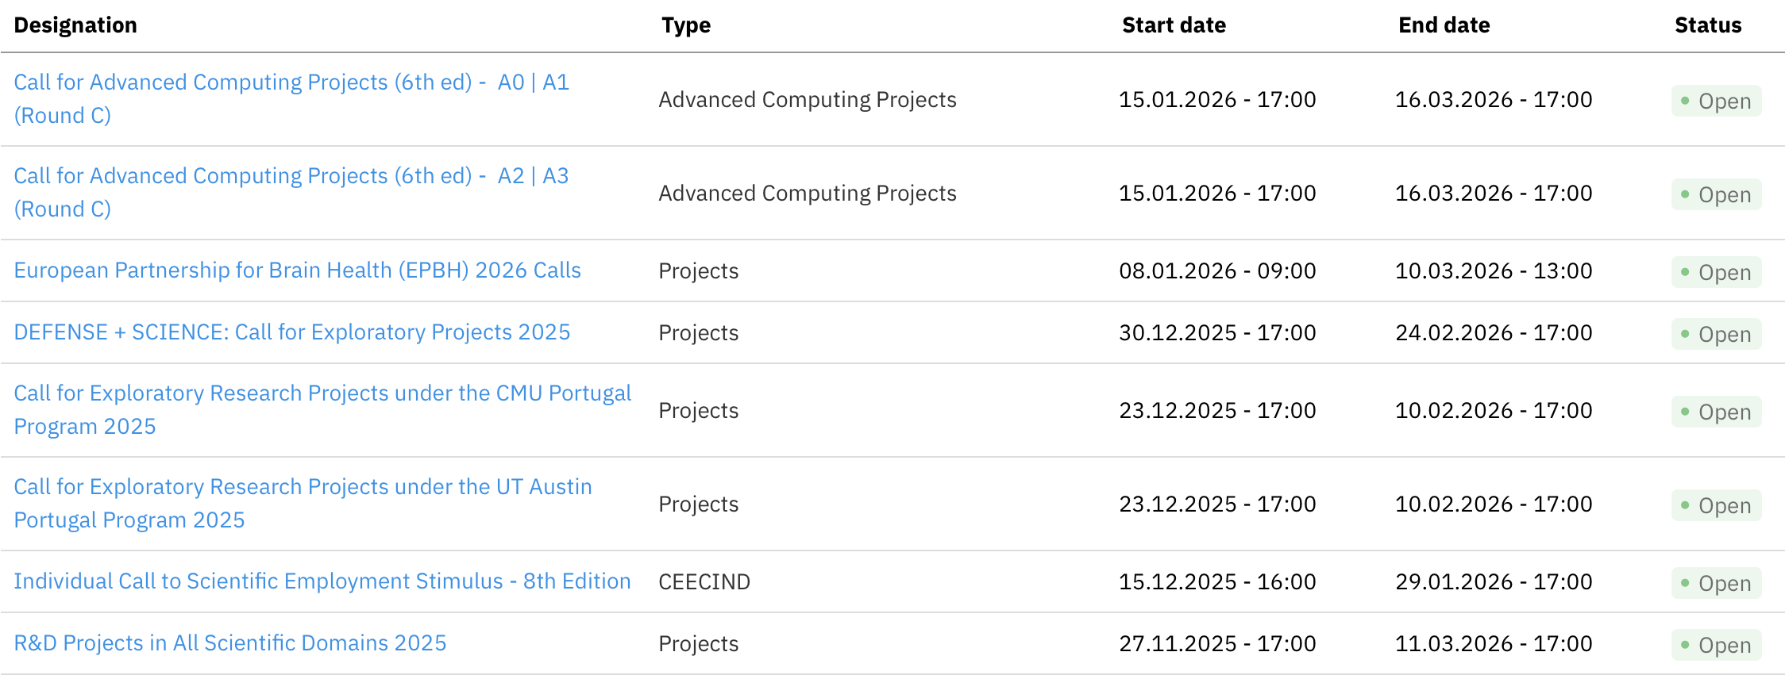
Start Your Journey
Source: https://myfct.fct.pt/MyFCT/homepage.aspx

Slide 6
Call Advanced Computing Projects
A0 - Acesso Experimental | Experimental Access (Deucalion, Cirrus & Stratus)
A1 - Acesso Desenvolvimento | Development Access (Deucalion, Cirrus & Stratus)
A2 - Acesso Regular | Regular Access (Deucalion, MareNostrum 5, Cirrus & Stratus)
A3 - Acesso Maior Dimensão | Larger Access (Deucalion & MareNostrum 5)
Source: https://myfct.fct.pt/MyFCT/homepage.aspx
Notes:
A0 – Experimental Access
For: Beginners & First-timers.
Purpose: Experimentation, visualization, and testing the platform.
Review: Technical check only (Fast approval).
Duration: 6 months.
A1 – Development Access
For: Developers & Optimizers.
Purpose: Code optimization, benchmarking, and scalability testing.
Review: Technical check only.
Duration: 3 – 12 months.
A2 – Regular Access
For: Consolidated Scientific Projects.
Purpose: Standard production runs for research/innovation.
Review: Scientific Merit Evaluation + Technical check.
Duration: 12 months.
A3 – Larger Access
For: Massive Scale Projects.
Purpose: Projects requiring high volumes of resources (Deucalion & MareNostrum 5).
Review: Scientific Merit Evaluation + Technical check.
Duration: 12 months.

Slide 7
Call Advanced Computing Projects
 | A0 | A1 | A2 | A3
Computational Model | HPC, IA, Cloud |  |  | HPC, IA
Platforms | Cirrus, Stratus, Deucalion |  | Cirrus, Stratus, Deucalion, MareNostrum 5 | Deucalion, MareNostrum 5
Duration (months) | 6 | 12
CPU core.hours | 50.000 | 100.000 | 100.000 a 3.000.000 | 1.000.000 a 30.000.000
vCPU.hours |  |  | 1.200.000 | -
GPU.hours | 500 | 5.000 | 10.000 | 100.000
Quotas | 5% | 15% | 80%

Slide 8
Call Advanced Computing Projects
A0 - Acesso Experimental | Experimental Access (Deucalion, Cirrus & Stratus)
A1 - Acesso Desenvolvimento | Development Access (Deucalion, Cirrus & Stratus)
A2 - Acesso Regular | Regular Access (Deucalion, MareNostrum 5, Cirrus & Stratus)
A3 - Acesso Maior Dimensão | Larger Access (Deucalion & MareNostrum 5)
Source: https://myfct.fct.pt/MyFCT/homepage.aspx
Need more power? Apply to EuroHPC for access to European Tier-0 supercomputers (LUMI, Leonardo, etc.).
Industry/Commercial? Computing resources can be purchased directly for private R&D or pre-competitive innovation.

Slide 9
Cirrus' Hardware
Queue | The Engine (Hardware) | Best For...
CPU | AMD EPYC 7643 (96 cores, 512 GB RAM) | General-purpose HPC. Simulations, CFD, physics, chemistry, parallel CPU workloads.
Memory | AMD EPYC 7643 (96 cores, 2 TB RAM) | Memory-intensive applications. Bioinformatics, large datasets, graph processing.
GPU | NVIDIA Tesla T4 / V100s / A100 (16 GB / 32 GB / 64 GB RAM) | Deep Learning, Training models, heavy matrix math.

Slide 10
Deucalion’s Hardware
Partition | The Engine (Hardware) | Best For...
ARM | Fujitsu A64FX (48 Cores) | Efficiency. Physics, fluid dynamics...
x86 | AMD EPYC (128 Cores) | Compatibility. Standard stuff. If it runs on your laptop, it runs here (but faster).
GPU | NVIDIA A100 (40GB/80GB) | AI & Acceleration. Deep Learning, Training models, heavy matrix math.
Deucalion is a hybrid HPC. It has CPUs for standard math and GPUs for AI.

Slide 11
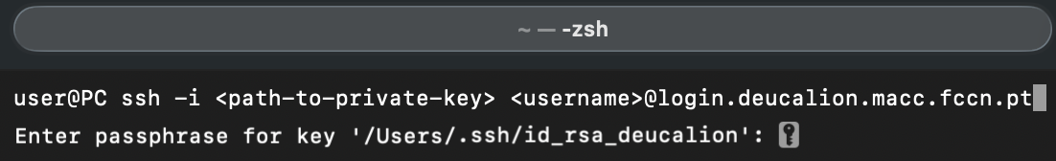
How to connect
If using a Microsoft Windows OS:
- MobaXTerm Home Edition (freely available from https://mobaxterm.mobatek.net/)
Alternatives for Windows OS/MacOS:
- Visual Studio Code (free)
- Using the terminal connect using SSH:
Details will be given on account creation.

Slide 12
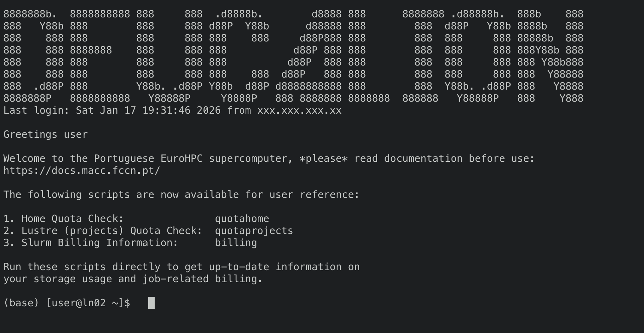
After log in

Slide 13
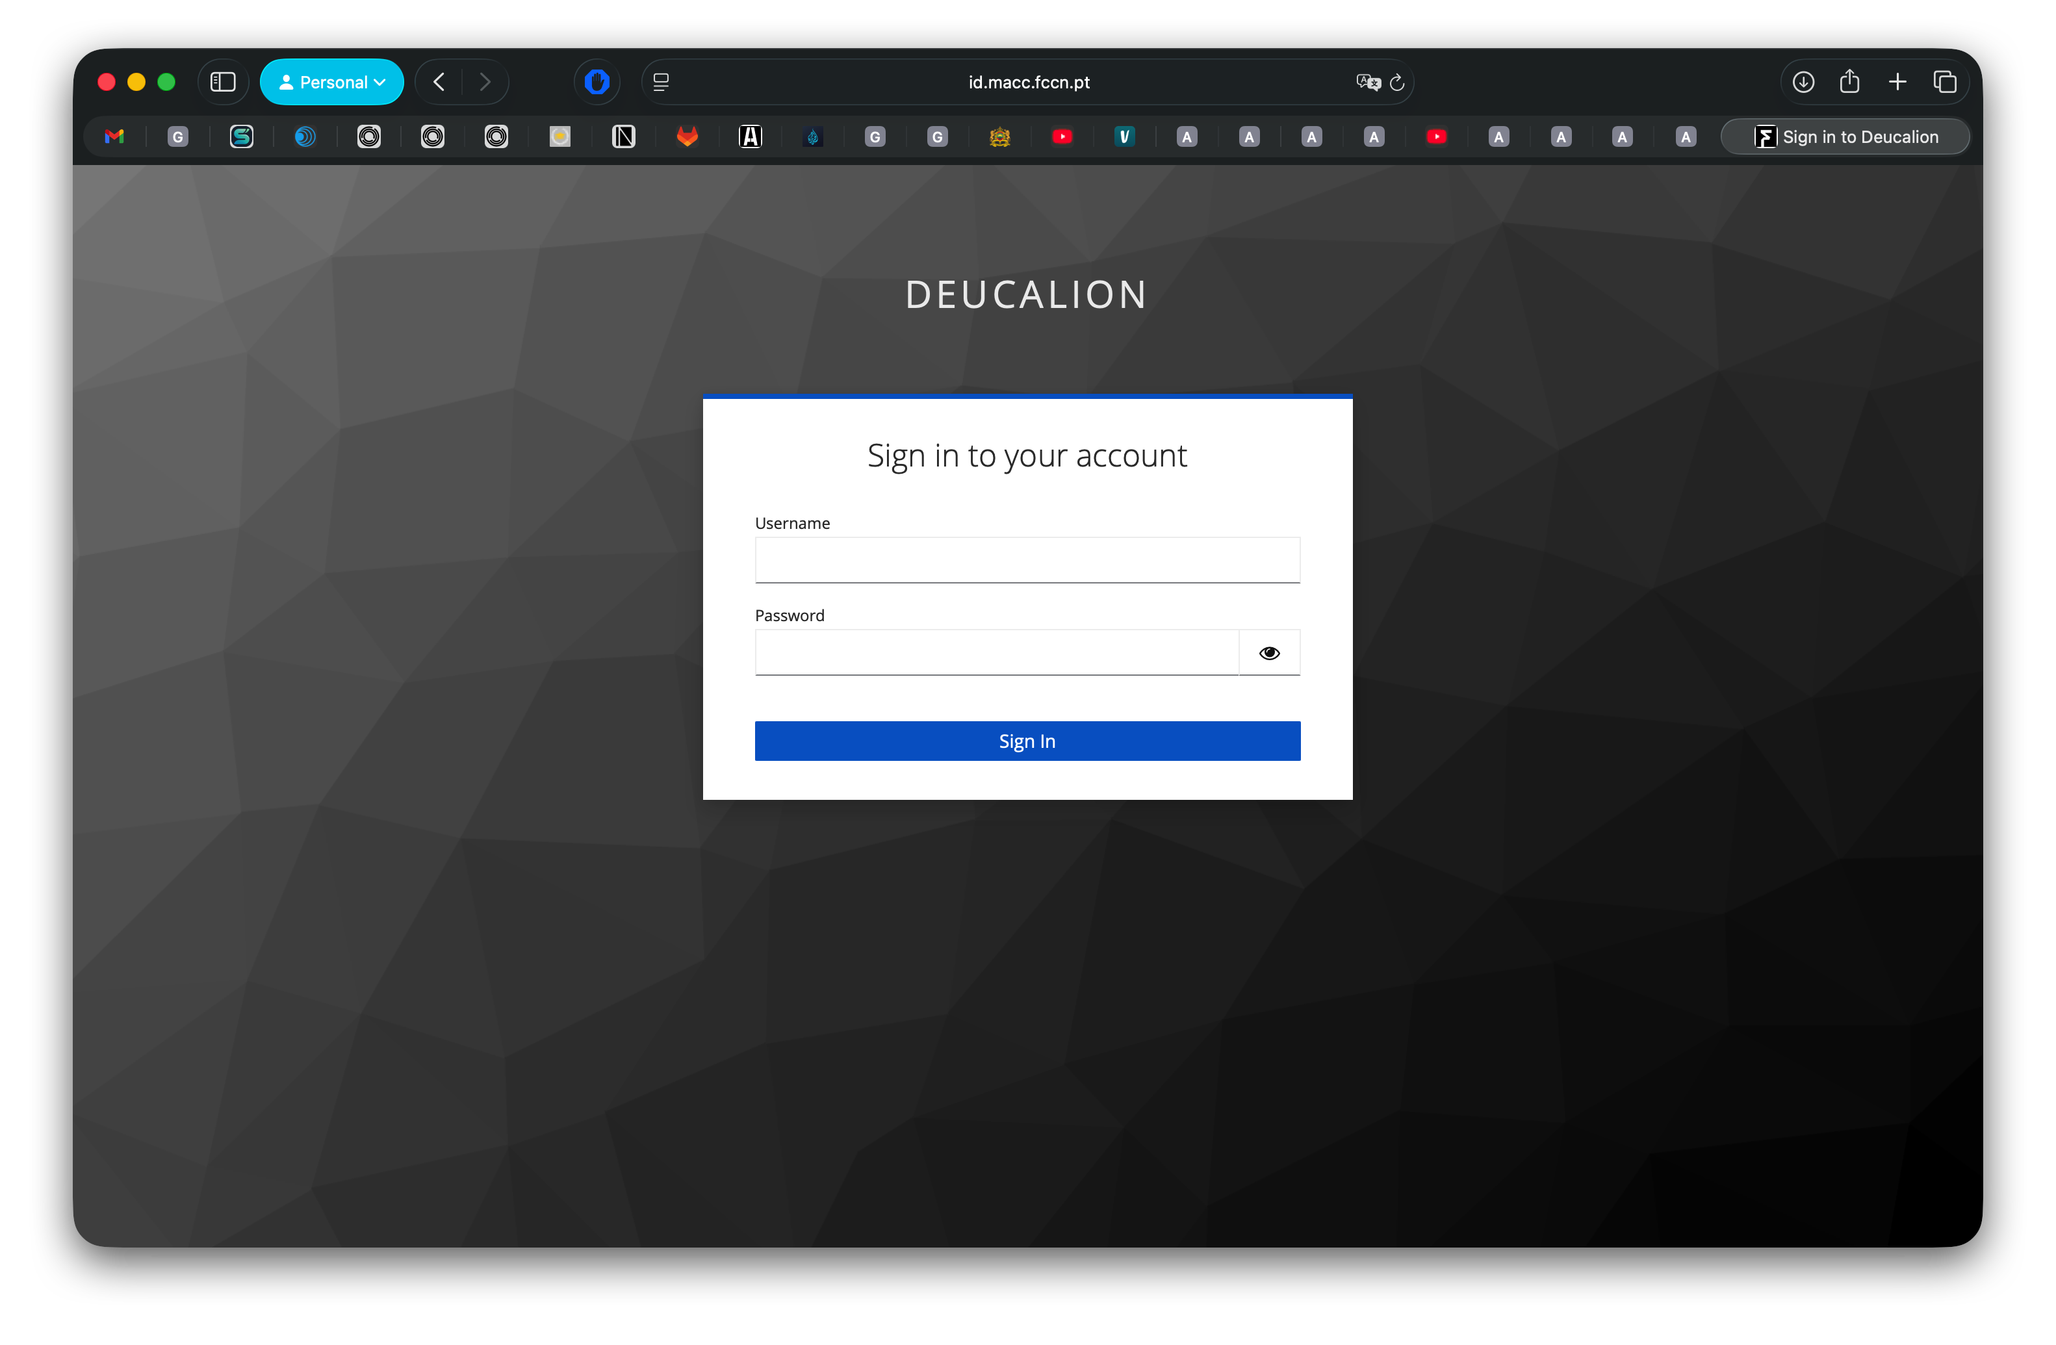
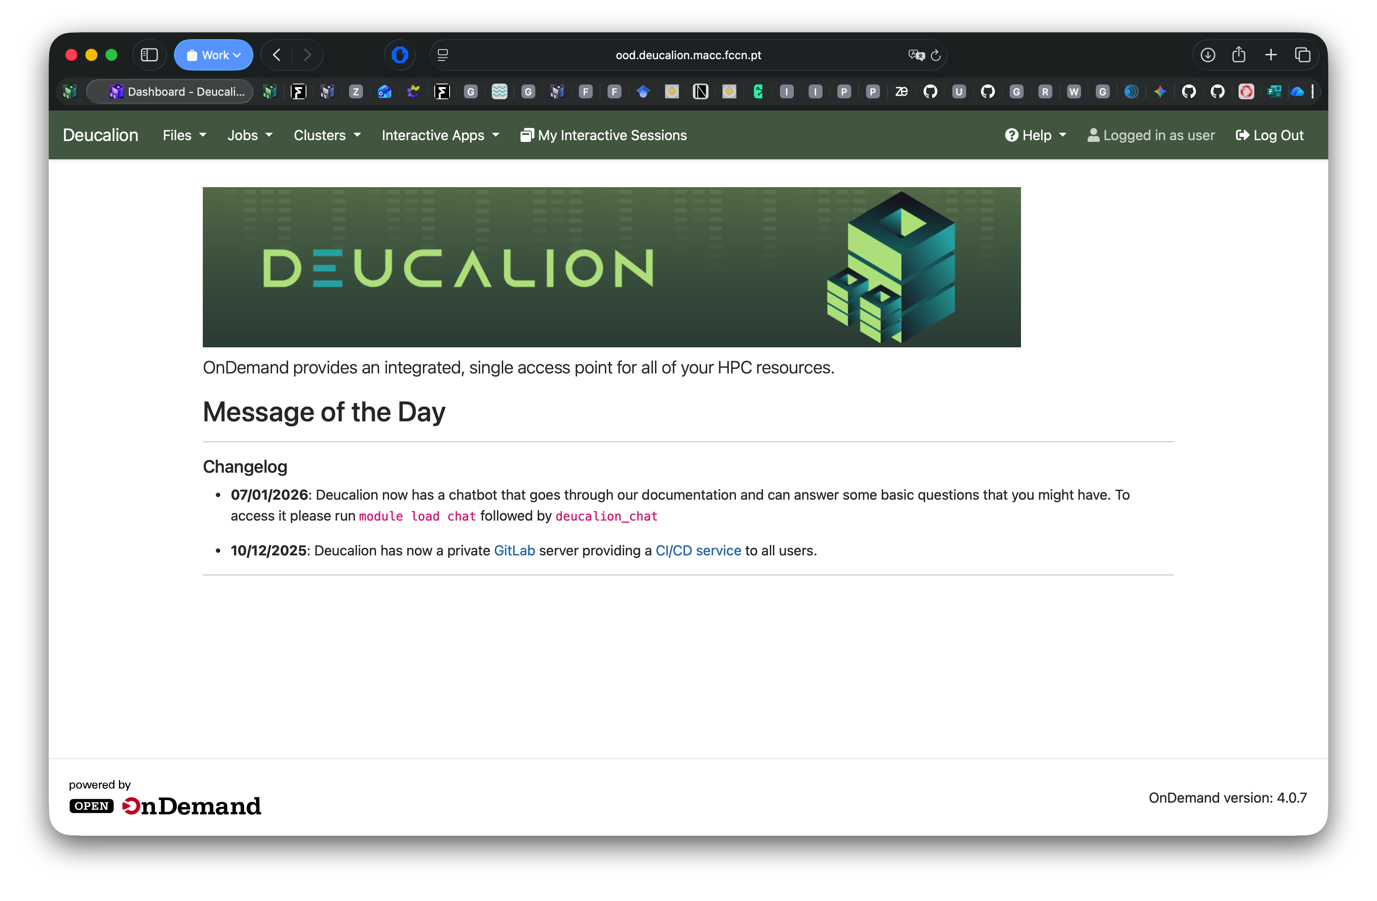
Open On Demand
https://login.deucalion.macc.fccn.pt/

Slide 14
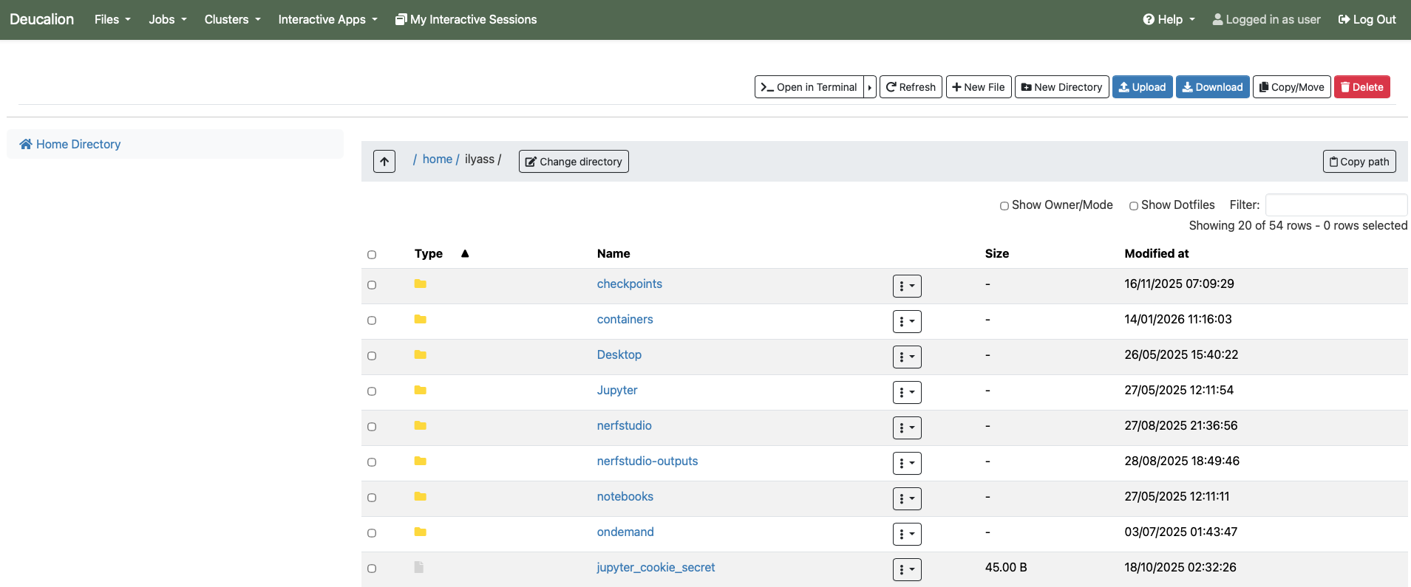
Open On Demand

Slide 15
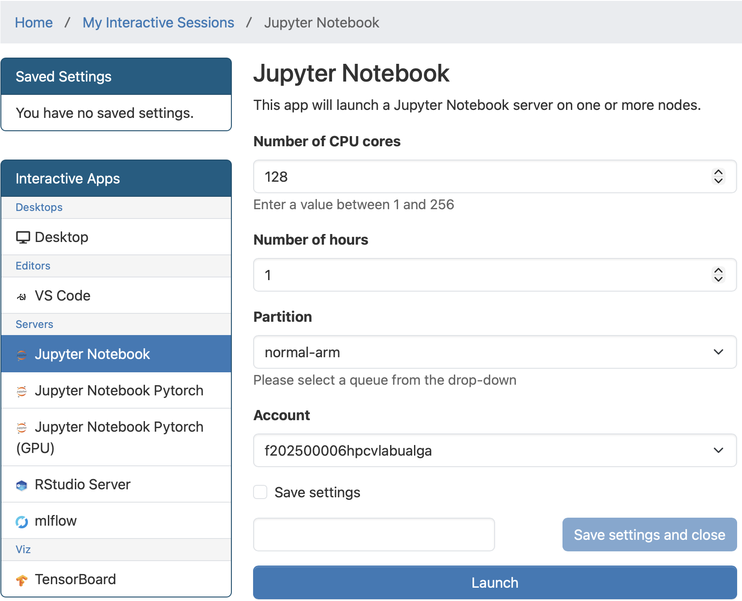
Open On Demand

Slide 16
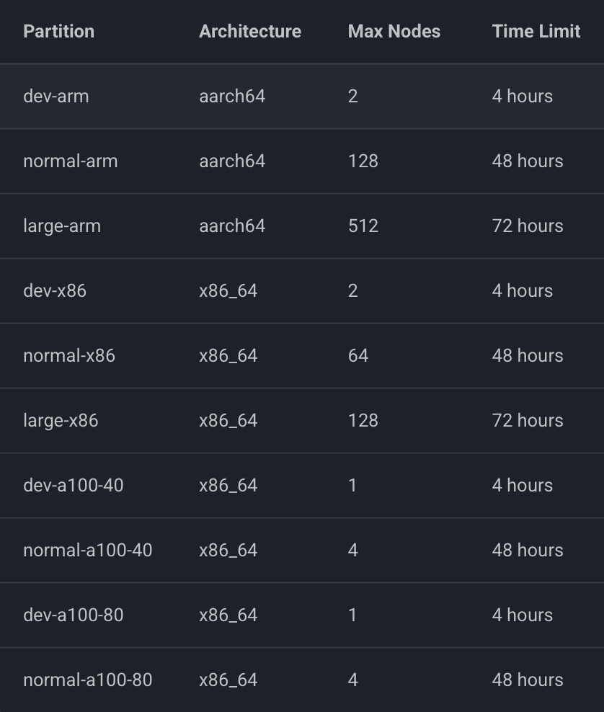
Partitions
Several Architectures: Deucalion supports four distinct computing paradigms.
Available hardware:
ARM (aarch64): Powered by Fujitsu A64FX processors (High Bandwidth Memory). Ideal for memory-bound applications.
x86 (x86_64): Powered by AMD EPYC processors. Standard general-purpose computing.
Accelerated (A100): Nodes equipped with NVIDIA A100 GPUs (40GB or 80GB VRAM) for AI and MD workloads.
Notes:
Open MP: Shared Mem
MPI: Distributed Mem
Hybrid: Both
Accelerated: GPU

Slide 17
Environment Management
Deucalion uses environment modules to manage compilers (GCC, Intel), MPI versions, Python, etc.
module avail # show available modules
module spider # search for a module
module load [module] # load a module
module list # list all loaded modules
module unload [module] # unload a module
module purge # unload all modules
Notes:
A module is a software manager used to handle different compilations required by different architectures.

Slide 18
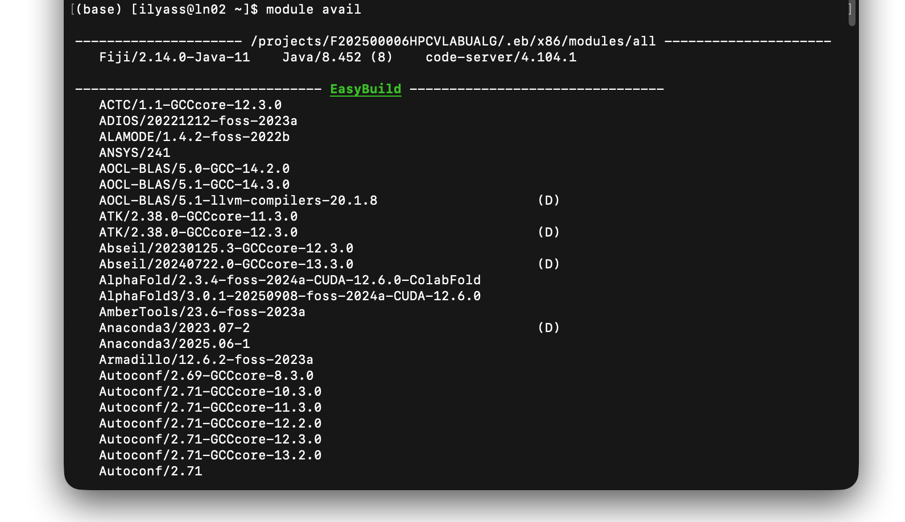
Environment Management
module avail

Slide 19
Environment Management
module avail # show available modules
module spider # search for a module
module load [module] # load a module
module list # list all loaded modules
module unload [module] # unload a module
module purge # unload all modules

Slide 20
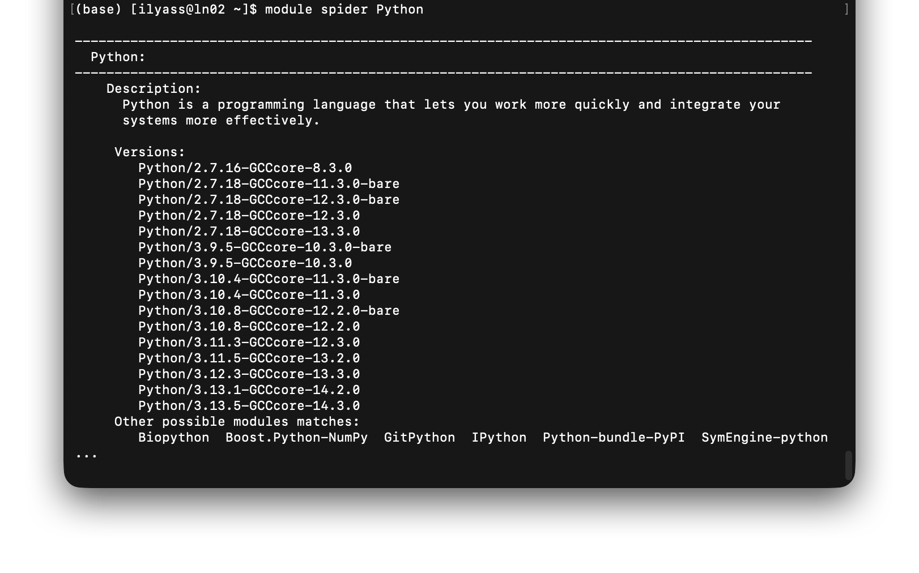
Environment Management
module spider

Slide 21
Environment Management
module avail # show available modules
module spider # search for a module
module load [module] # load a module
module list # list all loaded modules
module unload [module] # unload a module
module purge # unload all modules

Slide 22
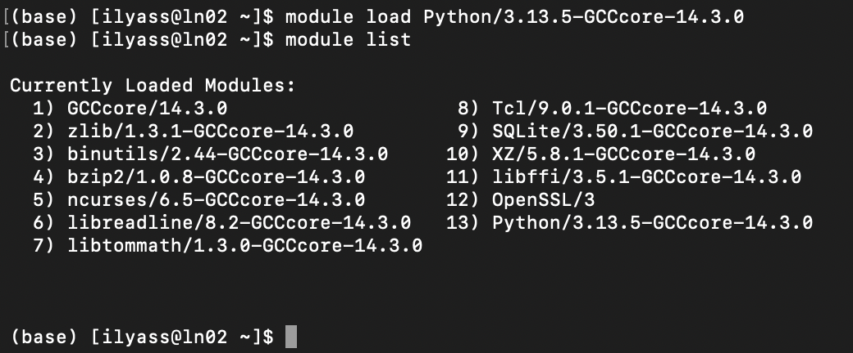
Environment Management
module load + module list

Slide 23
Environment Management
module avail # show available modules
module spider # search for a module
module load [module] # load a module
module list # list all loaded modules
module unload [module] # unload a module
module purge # unload all modules

Slide 24
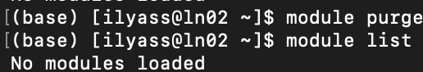
Environment Management
module unload [module] / module purge

Slide 25
Support
Check the Docs
Search the Error:
Google the error message + "slurm" or "linux".
Send message to HPCvLab-UAlg.
The Golden Rule:
"One Issue = One Ticket. Please don't bundle 5 different problems into one email."

Slide 26
References
Deucalion User Guide:
https://docs.macc.fccn.pt/
Cirrus User Guide:
https://wiki.incd.pt/shelves/hpc-htc-user-documentation
Contact us at:
https://hpcvlab.ualg.pt

Slide 27
Acknowledgements This initiative is supported by the project “NATIONAL COMPETENCE CENTRES IN THE FRAMEWORK OF EUROHPC PHASE 2 – EUROCC2”, funded by Fundação para a Ciência e Tecnologia, I.P., and “DIGITAL-EUROHPC-JU-2022-NCC-01” of the European High-Performance Computing Joint Undertaking ('JU’). Computer infrastructures targeted include Deucalion supercomputer and Cirrus supercomputer of CNCA - National Distributed Computing Infrastructure.

